Slide 1

REPORT ON
PROOF OF CONCEPT OF LORA COMMUNICATION USING PYCOM DEVICES
By
RAJAT SHUKLA
IIIT KALYANI
Under the joint guidence of Purnendu Debnath
ICT&Services-1,CDAC Kolkata

Slide 2
TABLE OF CONTENT
Acknowledgement................................................3
About Lopy...........................................................4
Lopy Features......................................................5
About LoRa..........................................................9
Firmware update..................................................12
FileZilla.................................................................14
Connecting LoPy with Computer..........................15
Traffic light programm...........................................17
Establising connection between two nodes..........19
Code for Sender....................................................19
Code for Receiver..................................................21
Applications............................................................22
Referances.............................................................23

Slide 3
ACKNOWLEDGEMENT
I am thankful to Dr.Nabarun Bhattacharya (Director,CDAC Kolkata) for his kind permission to work in this project.
I am highly indebted to Dr. Amit Chaudhary(Group Head ,ICT& Services,CDAC Kolkata) and Shri Biswajit Saha(Section Head,ICT&Services-1,CDAC Kolkata) for their valued guidance received during building of this project and for getting his generous help in every manner.
I pay my best regard to Shri purnendu Debnath(senior technical officer,ICT&S-1, CDAC Kolkata) for his constant guidance &encouragement during the course of my project.I am also thankful to Mr Abhijit Chatterjee(Project Engineer, CDAC Kolkata ) for his technical help and constant inspiration.

Slide 4
About LoPy:
The LoPy is a triple bearer MicroPython enabled microcontroller (LoRa, Wifi, Bluetooth) – perfect enterprise grade IoT platform for your connected Things. With the latest Espressif chipset the LoPy offers a perfect combination of power, friendliness and flexibility. Create and connect you things everywhere.
The LoPy can act as both a LoRa Nano Gateway and a multi-bearer (LoRa, WiFi and BLE) development platform suitable for all LoRa networks around the globe. It is programmable with MicroPython and the Pymakr plugin IDE for fast IoT application development, easy programming in-field and extra resilience with network failover. The best blend of speed to deployment and access to new LPWAN networks rolling out across Europe, USA, Africa and India. The LoPy is CE, FCC approved and is LoRaWAN certified.

Slide 5
LoPy Features:
– Powerful CPU, BLE and state of the art WiFi radio. 1KM Wifi Range
– Can also double up as Nano LoRa gateway
– MicroPython enabled
– Fits in a standard breadboard (with headers)
– Ultra-low power usage: a fraction compared to other connected micro controllers
Processing:
– Espressif ESP32 chipset
– Dual processor + WiFi radio System on chip
– Network processor handles the WiFi connectivity and the IPv6 stack
– Main processor is entirely free to run the user application
– An extra ULP-coprocessor that can monitor GPIOs, the ADC channels and control most of the internal peripherals during deep-sleep mode while only consuming 25uA

Slide 6
Operating Frequencies:
– 868 MHz (Europe) at +14dBm maximum
– 915 MHz (North and South America, Australia and New Zealand) at +20dBm maximum
Range Specification:
– Node range: Up to 40km
– Nano-gateway: Up to 22km
– Nano-gateway capacity: Up to 100 nodes
Interfaces:
– 2 x UART, 2 x SPI, I2C, I2S, micro SD card
– Analog channels: 8×12 bit ADCs
– Timers: 4×16 bit with PWM and input capture
– DMA on all peripherals
– GPIO: Up to 24

Slide 7
Security & Certifications:
– SSL/TLS support
– WPA Enterprise security
– FCC – 2AJMTLOPY2R
– CE 0700
Memory:
– RAM: 512KB
– External flash: 4MB
– Hardware floating point acceleration
– Python multi-threading
Hash / encryption:
SHA, MD5, DES, AES
WiFi:
802.1b/g/n 16mbps

Slide 8
Bluetooth:
Low energy and classic
RTC:
Running at 32KHz
Power:
– Input: 3.3V – 5.5V
– 3v3 output capable of sourcing up to 400mA
– WiFi: 12mA in active mode, 5uA in standby
– LoRa: 15mA in active mode, 1-uA in standby
LoRa Specification:
– Semtech LoRa transceiver SX1272
– LoRaWAN stack
– Class A and C devices
Size:
55mm x 20mm x 3.5mm (Without Headers)
Weight :(7 grams)

Slide 9
About LoRa:
LoRaWAN™ is a Low Power Wide Area Network (LPWAN) specification intended for wireless battery operated Things in a regional, national or global network. LoRaWAN targets key requirements of Internet of Things such as secure bi-directional communication, mobility and localization services. The LoRaWAN specification provides seamless interoperability among smart Things without the need of complex local installations and gives back the freedom to the user, developer, businesses enabling the roll out of Internet of Things.
LoRaWAN network architecture is typically laid out in a star-of-stars topology in which gateways is a transparent bridge relaying messages between end-devices and a central network server in the backend. Gateways are connected to the network server via standard IP connections while end-devices use single-hop wireless communication to one or many gateways. All end-point communication is generally bi-directional, but also supports operation such as multicast enabling software upgrade over the air or other mass distribution messages to reduce the on air communication time.

Slide 10
Communication between end-devices and gateways is spread out on different frequency channels and data rates. The selection of the data rate is a trade-off between communication range and message duration. Due to the spread spectrum technology, communications with different data rates do not interfere with each other and create a set of "virtual" channels increasing the capacity of the gateway. LoRaWAN data rates range from 0.3 kbps to 50 kbps. To maximize both battery life of the end-devices and overall network capacity, the LoRaWAN network server is managing the data rate and RF output for each end-device individually by means of an adaptive data rate (ADR) scheme.
​
National wide networks targeting internet of things such as critical infrastructure, confidential personal data or critical functions for the society has a special need for secure communication. This has been solved by several layer of encryption:
​
Unique Network key (EUI64) and ensure security on network level
Unique Application key (EUI64) ensure end to end security on application level
Device specific key (EUI128)

Slide 11
Bi-directional end-devices (Class A): End-devices of Class A allow for bi-directional communications whereby each end-device's uplink transmission is followed by two short downlink receive windows. The transmission slot scheduled by the end-device is based on its own communication needs with a small variation based on a random time basis (ALOHA-type of protocol). This Class A operation is the lowest power end-device system for applications that only require downlink communication from the server shortly after the end-device has sent an uplink transmission. Downlink communications from the server at any other time will have to wait until the next scheduled uplink.
​​
Bi-directional end-devices with scheduled receive slots (Class B): In addition to the Class A random receive windows, Class B devices open extra receive windows at scheduled times. In order for the End-device to open its receive window at the scheduled time it receives a time synchronized Beacon from the gateway. This allows the server to know when the end-device is listening.
​​
Bi-directional end-devices with maximal receive slots (Class C): End-devices of Class C have nearly continuously open receive windows, only closed when transmitting. Class C

Slide 12
Firmware update:
1.Download Firmware update tool from https://www.pycom.io/ according to your operating system.I downloded for linux.
2. Disconnect your device(LoPy) from your computer
3.Connect a jumper cable or wire between G23 and GND
4.Reconnect the board via USB to your computer
5.Run the Firmware Upgrade tool
6.Remove the G23 to GND jumper cable/wire
7.Reboot the device (button or power off then on)
8.Connecting G23 and GND puts the device in ‘firmware update mode’. (This mode is only used for updating the device’s firmware using the Firmware Update tool.)

Slide 13
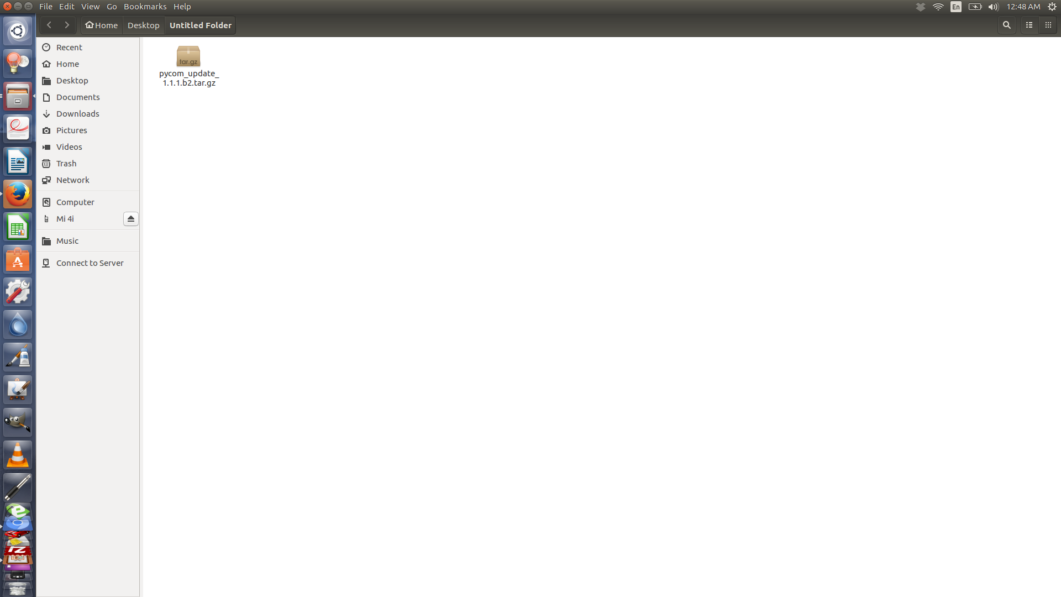
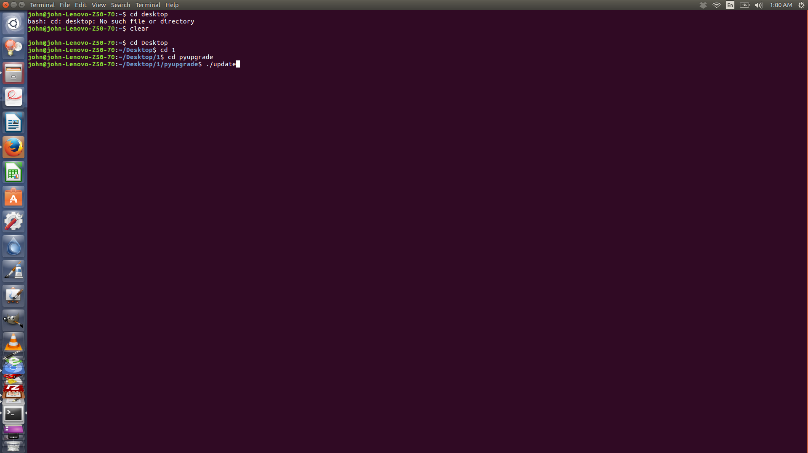
1.This is the downloaded file for firmware update extract this. 2. After that go to terminal go to directory pyupgrade and run “./update”. 3.Now your device(Lopy) is ready to be programmed .

Slide 14
FileZilla:
The free FTP solution for both client and server. Filezilla is open source software distributed free of charge.
Install Filezilla to your computer.

Slide 15
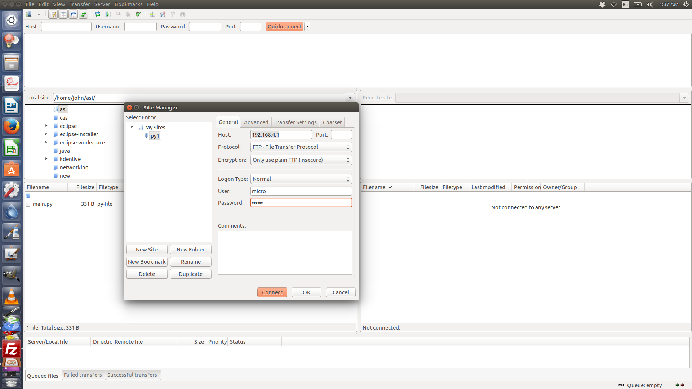
Connecting Lopy with Computer:
Connect Lopy with power.
Lopy will generate a wifi signal ,connect this with your laptop as wifi (Password is www.pycom.io)....
Now open FileZilla connect to the lopy as given in following fig.
Usename:micro & Password:python.

Slide 16
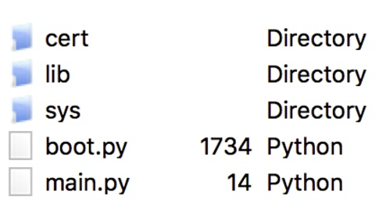
You will get these files &folders.
Replace the code of main.py with the code which you wnat to run on LoPy.
Now press the restart button of Lopy.

Slide 17
Traffic light programm:
import pycom
import time
pycom.heartbeat(False)
for cycles in range(10): # stop after 10 cycles
pycom.rgbled(0x007f00) # green
time.sleep(5)
pycom.rgbled(0x7f7f00) # yellow
time.sleep(1.5)
pycom.rgbled(0x7f0000) # red
time.sleep(4)

Slide 18
class pycom – Pycom Device Features
The pycom module contains functions to control specific features of the pycom devices, such as the heartbeat RGB LED.
Quick Usage Example
import pycom
pycom.heartbeat(False) # disable the heartbeat LED
pycom.heartbeat(True) # enable the heartbeat LED
pycom.heartbeat() # get the heartbeat state
pycom.rgbled(0xff00) # make the LED light up in green color
Functions
pycom.heartbeat([enable])
Get or set the state (enabled or disabled) of the heartbeat LED. Accepts and returns boolean values (True or False).
pycom.rgbled(color)
Set the colour of the RGB LED. The color is specified as 24 bit value representing red, green and blue, where the red colour is represented by the 8 most significant bits. For instance, passing the value 0x00FF00 will light up the LED in a very bright green.

Slide 19
Establishing connection between two Nodes:
We can establish coonection between two LoPy devices .
One of them will be sender and the other will be receiver end.
Code for Sender:
from network import LoRa
import socket
import time
import pycom
lora = LoRa(mode=LoRa.LORA, frequency=863000000)
pycom.heartbeat(False)
s = socket.socket(socket.AF_LORA, socket.SOCK_RAW)
s.setblocking(False)
while True:
s.send('Pong')
pycom.rgbled(0x00ff00)
time.sleep_ms(1000)
pycom.rgbled(0x000000)
time.sleep_ms(29000)

Slide 20
class Socket
Methods
socket.close()
Mark the socket closed. Once that happens, all future operations on the socket object will fail. The remote end will receive no more data (after queued data is flushed).
Sockets are automatically closed when they are garbage-collected, but it is recommended to close() them explicitly, or to use a with statement around them.
socket.bind(address)
Bind the socket to address. The socket must not already be bound. The address parameter must be a tuple containing the IP address and the port.
socket.setblocking(flag)
Set blocking or non-blocking mode of the socket: if flag is false, the socket is set to non-blocking, else to blocking mode.
This method is a shorthand for certain settimeout() calls:
sock.setblocking(True) is equivalent to sock.settimeout(None)
sock.setblocking(False) is equivalent to sock.settimeout(0.0)

Slide 21
Code for receiver: from network import LoRa import socket import time import pycom pycom.heartbeat(False) lora = LoRa(mode=LoRa.LORA, frequency=863000000) s = socket.socket(socket.AF_LORA, socket.SOCK_RAW) s.setblocking(True) while True: print(s.recv(64)) pycom.rgbled(0xff0000) time.sleep_ms(1000) pycom.rgbled(0x0000) time.sleep_ms(1)

Slide 22
Applictions
With the growing Internet of Things, Microchip has a LoRa® technology wireless solution to address increasing demands on end-devices for long range connectivity, low-power for battery operation, and low infrastructure cost for volume deployment.
Microchip’s LoRa technology solution is ready to run out-of-the box and with the complete LoRaWAN protocol and certifications in place, it reduces time to market and saves development costs.
LoRa Technology is ideal for battery-operated sensor and low-power applications such as:
Internet of Things
Smart agriculture
Smart city
Sensor networks
Industrial automation
Smart meters

Slide 23
Referances
www.pycom.io
https://www.microchip.com
https://www.wikipedia.org/

